Slide 1
Evolution
Who was Charles Darwin?
What is natural Selection?

Slide 2
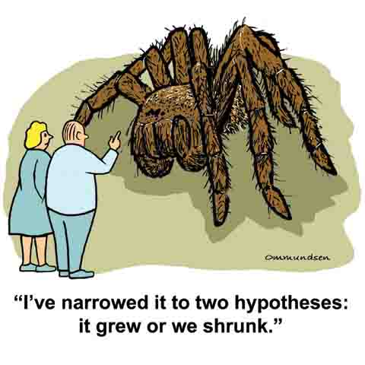
Hypothesis
Tentative/ testable statement made about 2 or more variables based on prior knowledge and observation.

Slide 3
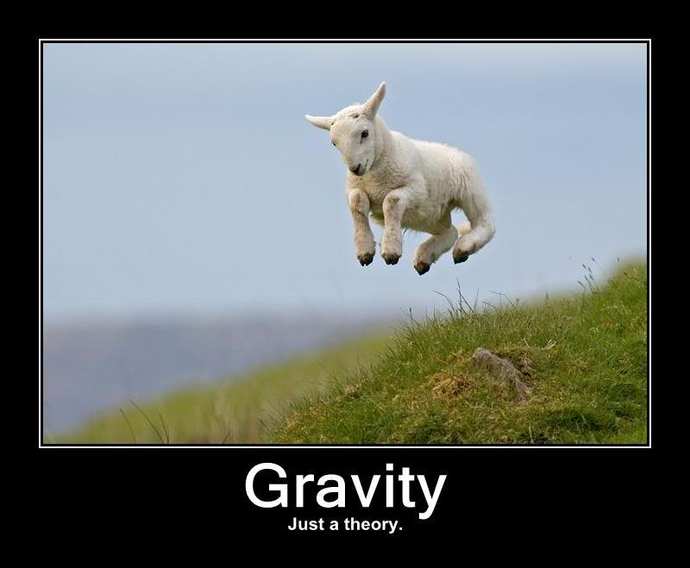
Theory
A theory in science is a broad explanation that has been scientifically tested a supported. Like most scientific theories, evolutionary theory keeps developing and expanding.

Slide 4
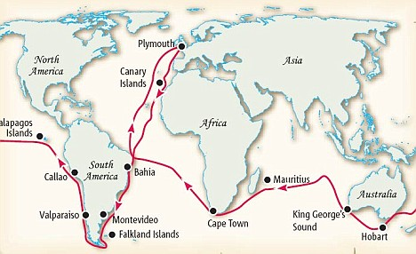
Darwin
Darwin was a naturalist on a ship called the Beagle. He collected specimens and observed patterns among animals on different islands.

Slide 5
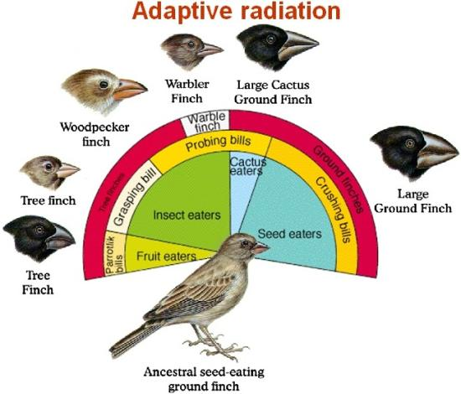
Darwin’s observations
Darwin observed
that finches
adapted by
having beaks
that are specific
to the type of food
they eat

Slide 6
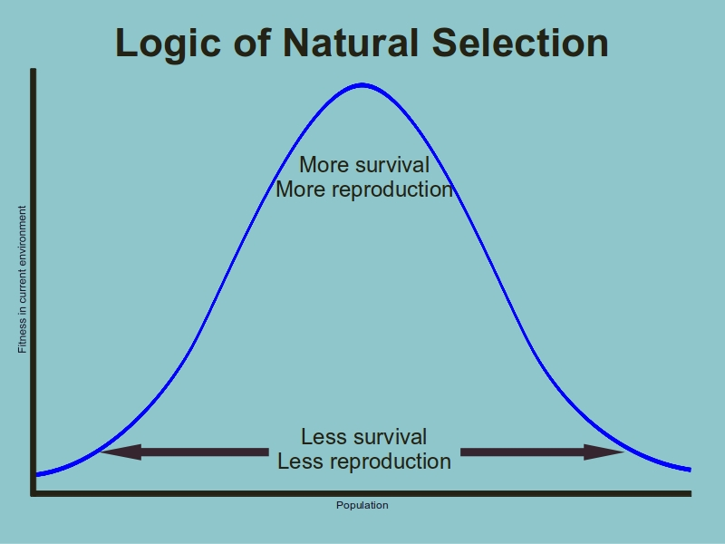
Evolution by Natural Selection
Darwin’s explanation is often called the theory of evolution. It predicts that over time, the number of individuals that carry advantageous traits will increase in a population.
Natural Selection is
Also know as
Survival of the fittest.

Slide 7
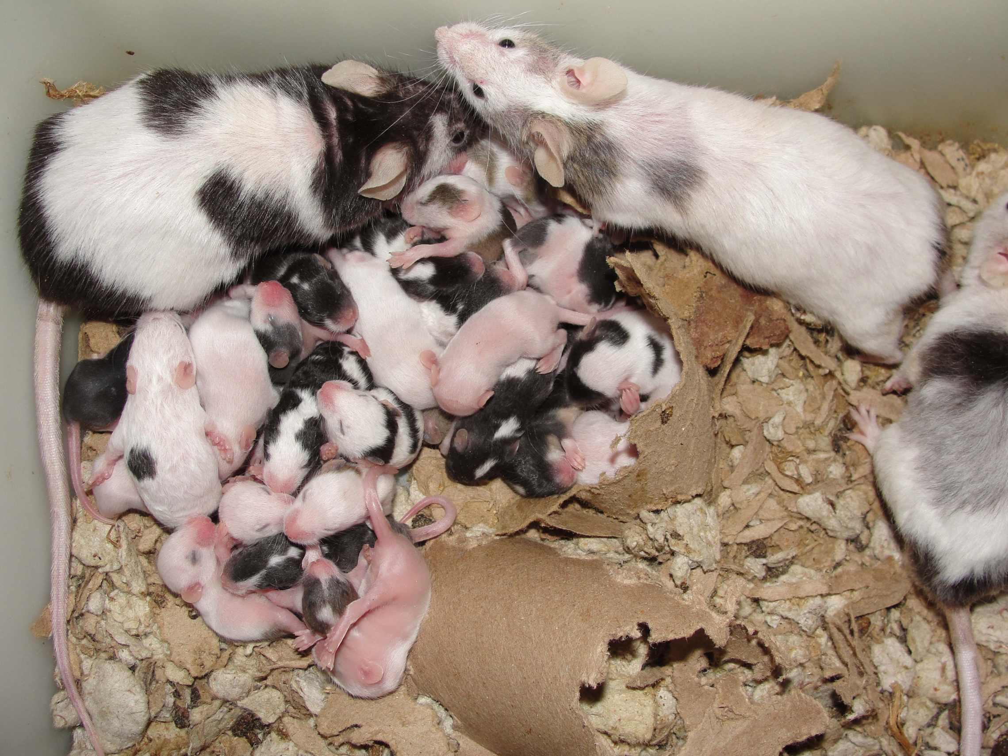
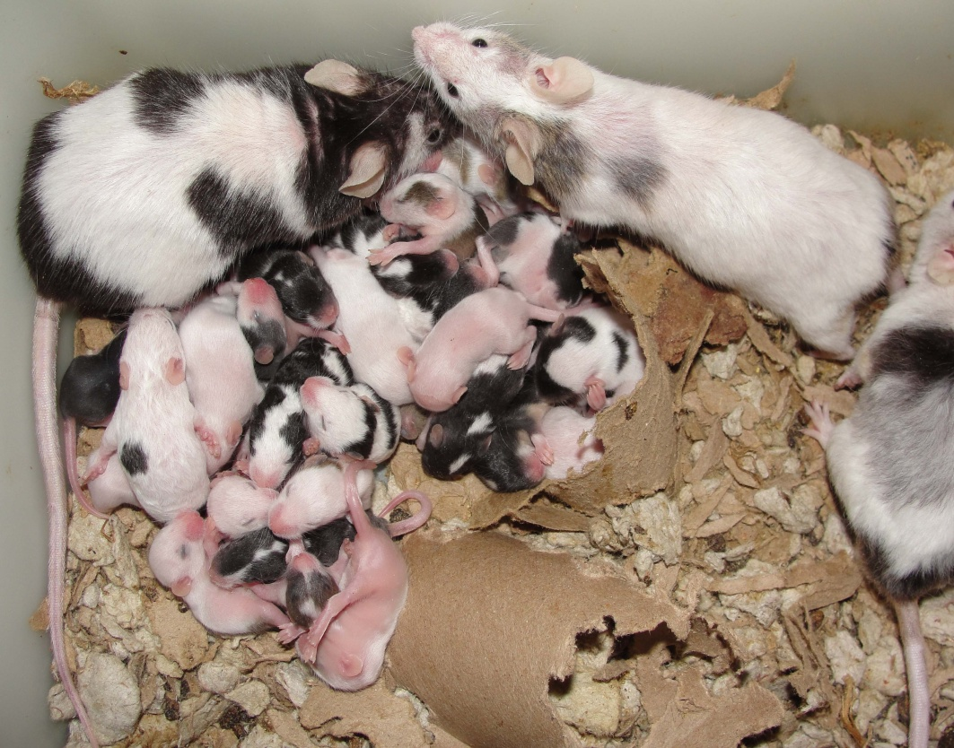
Steps of Natural Selection
1. Overproduction: Every population is capable of producing more offspring than can possibly survive.

Slide 8
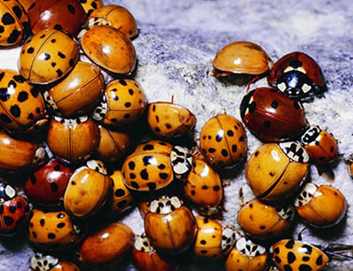
2. Variation:
variation exists within every population. Much of this variations in the form of inherited traits.

Slide 9
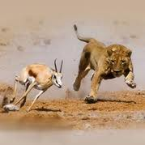
3. Selection:
In a given environment, having a particular trait can make individual more or less likely to survive and have successful offspring. So some individuals leave more offspring than others.

Slide 10
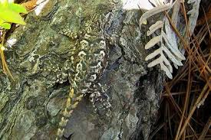
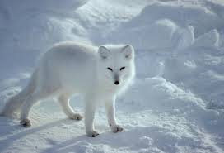
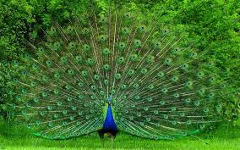
4. Adaptation
Smart...
Over time, those traits that improve survival and reproduction will become more common
Most Fit: strongest, fastest, smartest, most camouflaged, most able to attract the ladies…
High Fitness

Slide 11
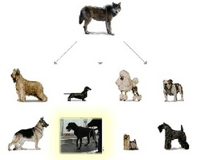
Darwin took an interest in breeding
Humans can breed animals for specific characteristics. Darwin called this process Artificial Selection
foxes

Slide 12
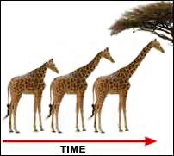
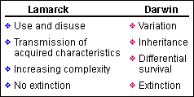
Jean Baptiste Lamarck
inheritance of acquired characteristics

Slide 13
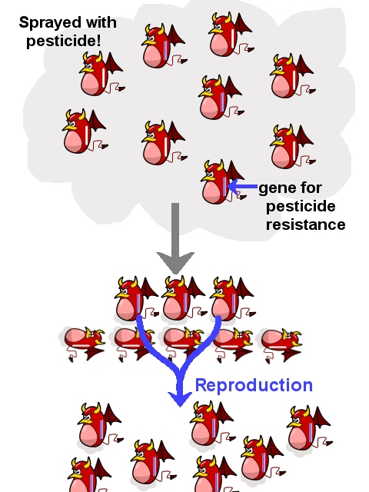
Microevolution
Microevolution is the change in allele frequencies that occur over time within a population

Slide 14
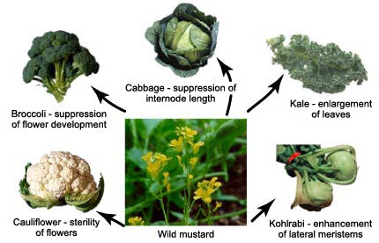
Macroevolution
Macroevolution refers to major evolutionary changes over time, the origin of new types of organisms from previously existing, but different, ancestral types

